Slide 1

SQL Sunday
D205 SQL for Data Analytics
Postgres database
Notes:
D205 SQL Sunday.

Slide 2
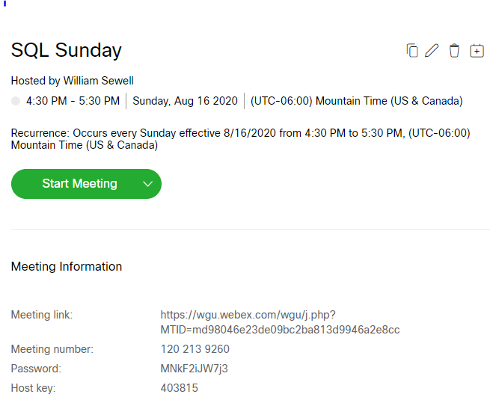

https://wgu.Webex.com/wgu/j.php?MTID=md98046e23de09bc2ba813d9946a2e8cc
Notes:
MEETING NUMBER: 120 213 9260
MEETING PASSWORD: MNkF2iJW7j3
Occurs First Three Sundays of each month at 4:30pm Mountain time for 1 hour.
This is the meeting information. We will meet at the same time with the same meeting number and Password for the first three Sundays of each month. On the fourth Sunday of the month, I will not present but record the items we discussed and send out the recording and the PowerPoint slides.

Slide 3
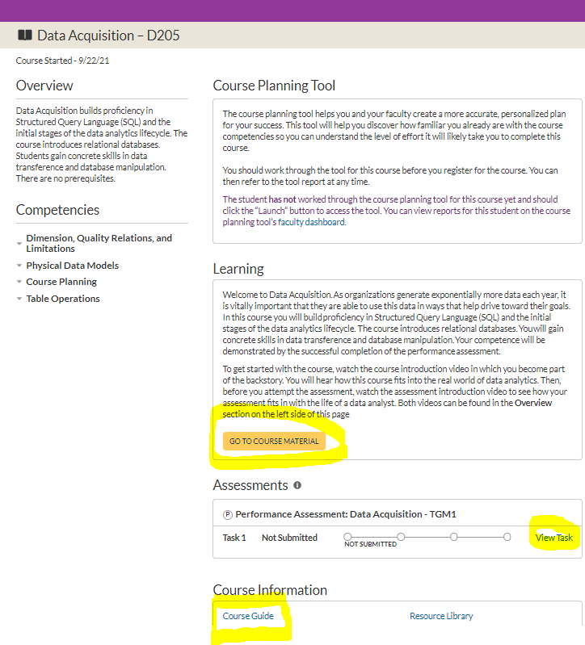

Notes:
Main course landing page.

Slide 4
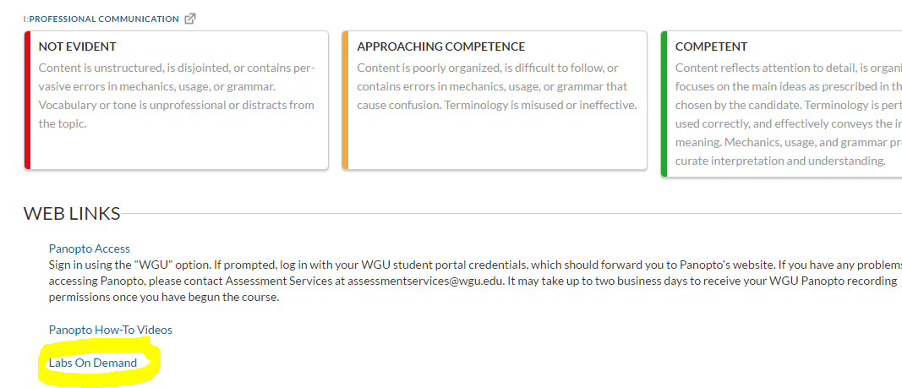
Notes:
At the bottom of the rubric page is Labs on Demand

Slide 5
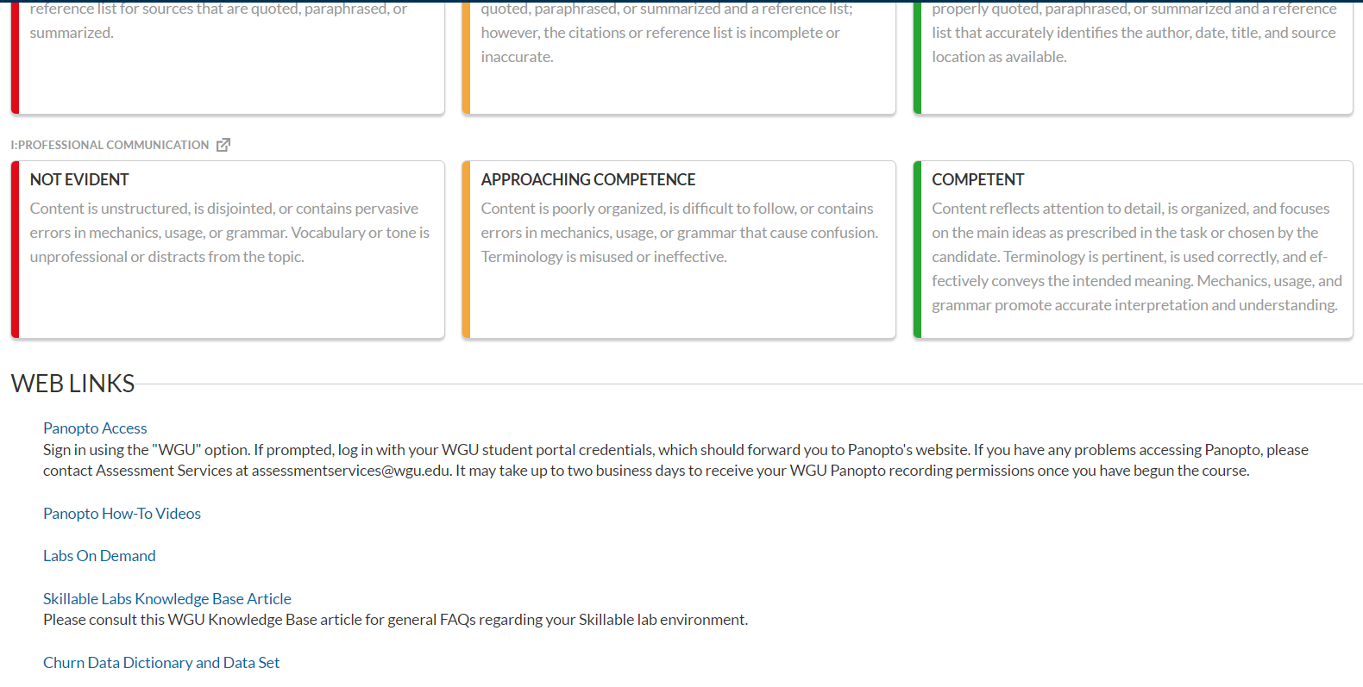
Notes:
At the bottom of the rubric page is Labs on Demand

Slide 6
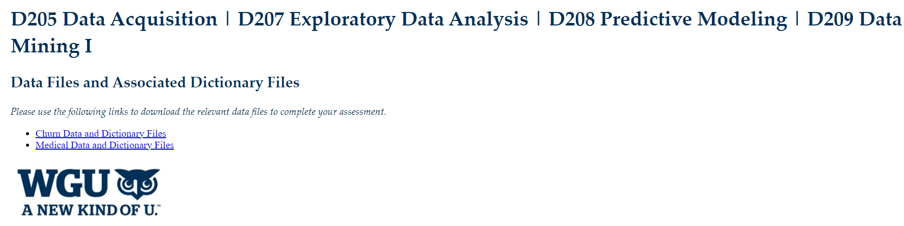
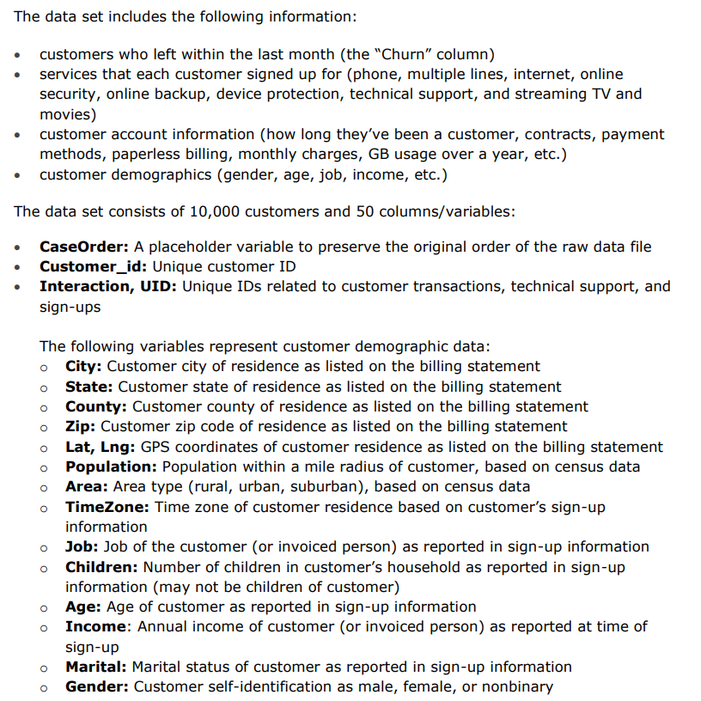
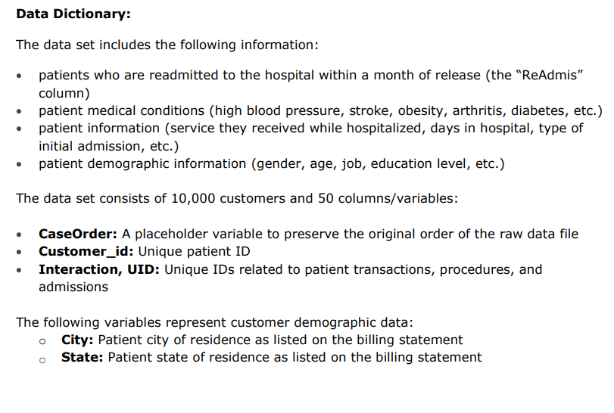
Notes:
At the bottom of the rubric page is Labs on Demand

Slide 7
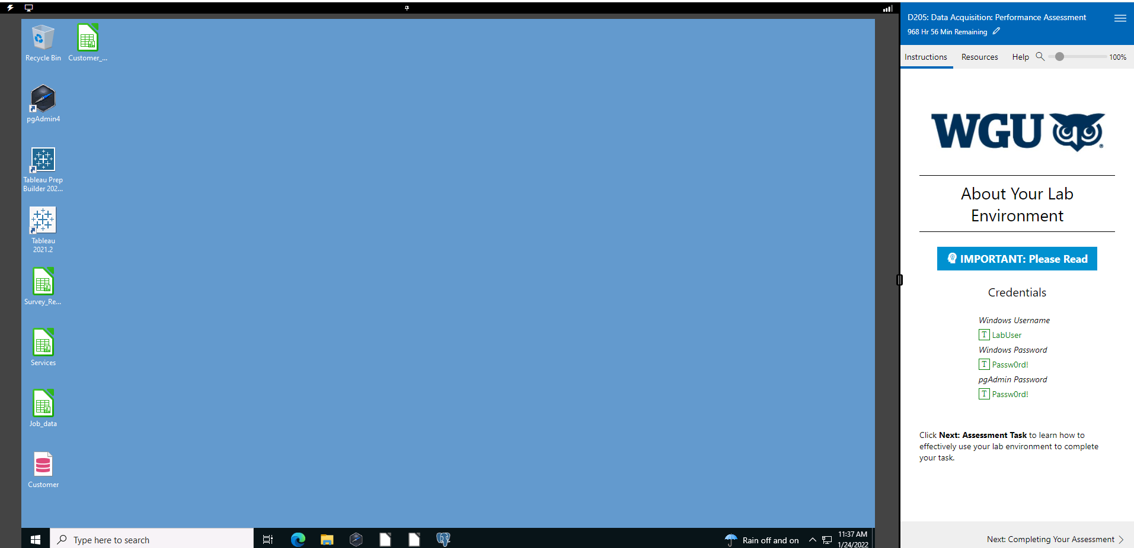
On the left Bringing PgAdmin back to life and Saving your session
On the right side, click the three parallel bars to save your session.’
Bringing PgAdmin back to life and Saving your session.
Notes:
This is the Labs on Demand landing page. It is a Virtual Machine, hosting Postgres. Upper left: bring PgAdmin back to life with Lightning bolt or Display. Upper right: Save your session.

Slide 8
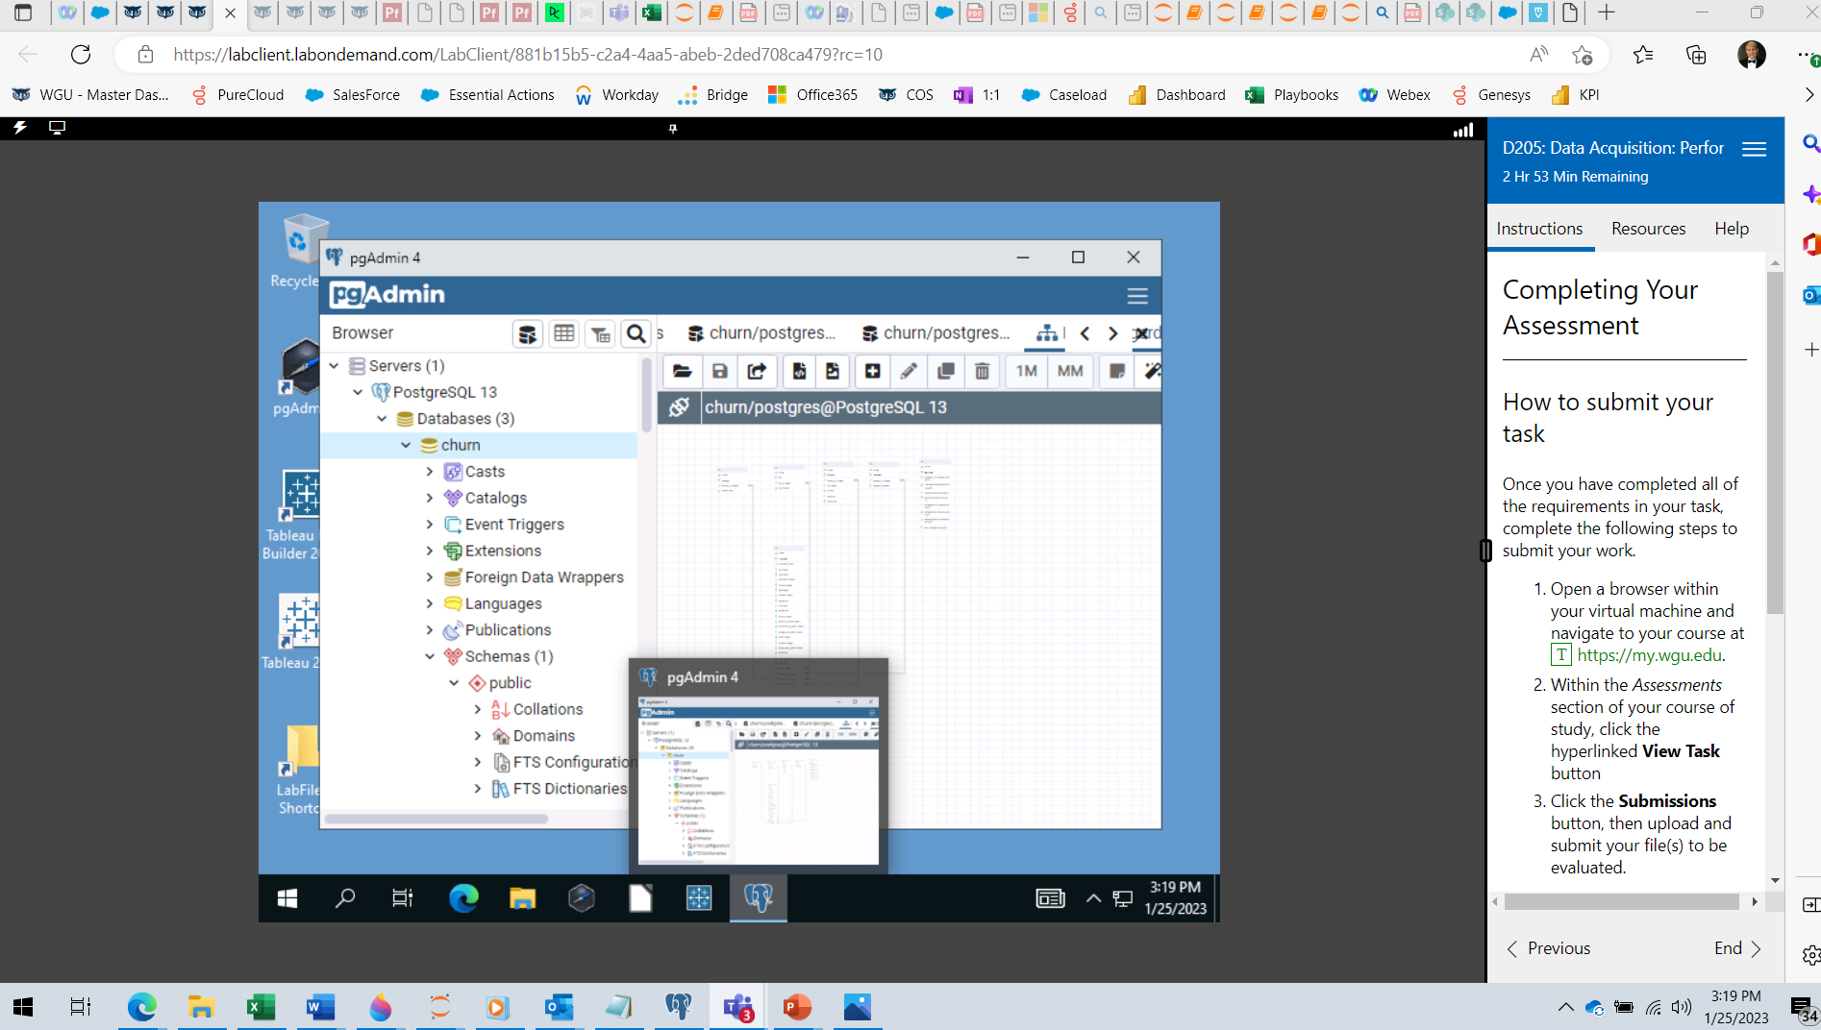
Notes:
At the bottom of the rubric page is Labs on Demand

Slide 9
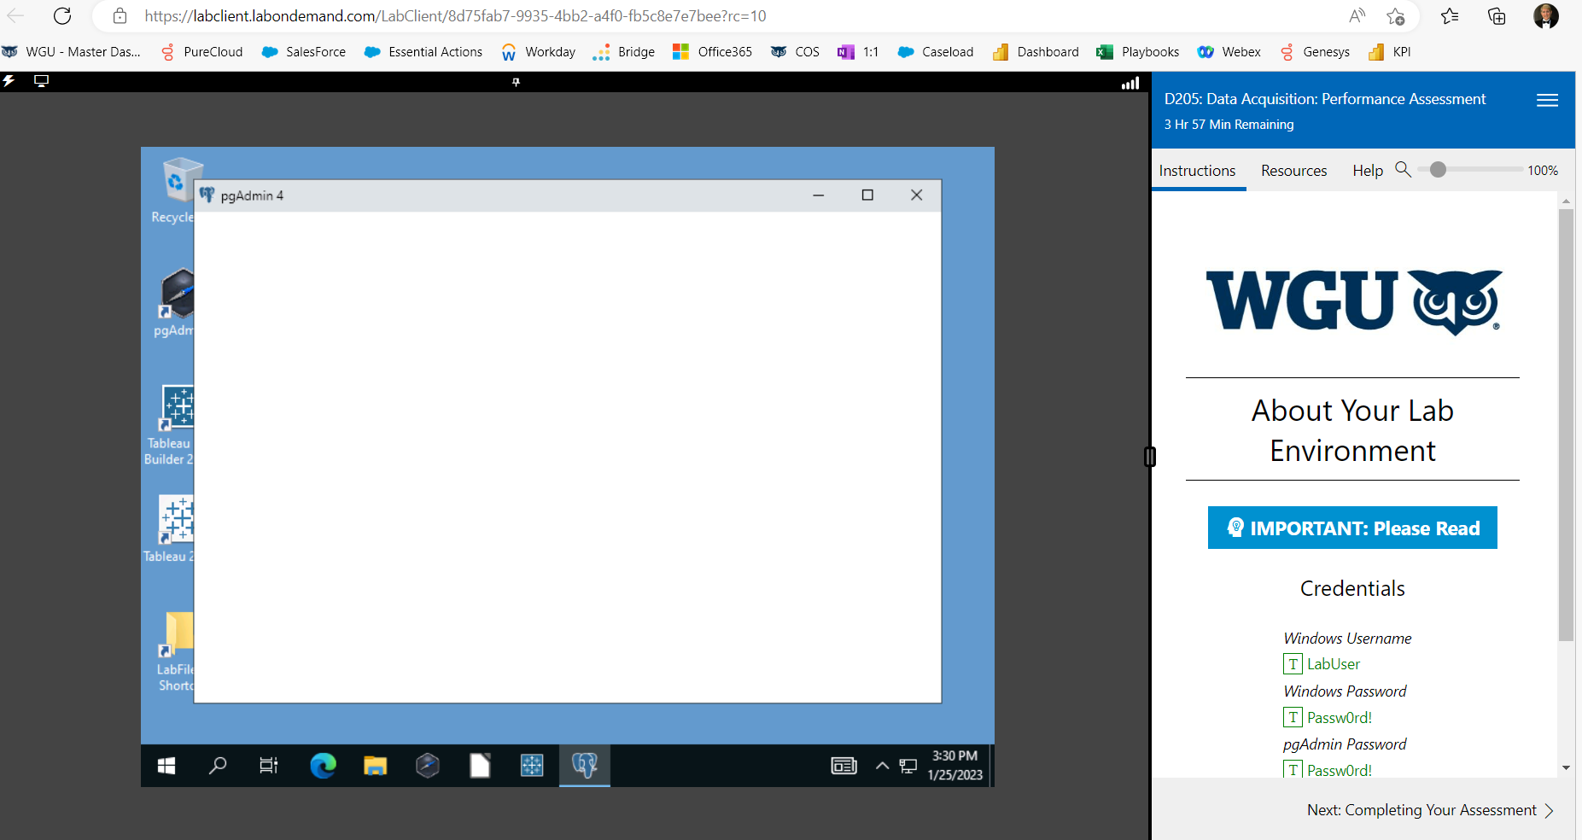
Notes:
If this happens, click on the blue background and then on pgAdmin and it will come to life!

Slide 10
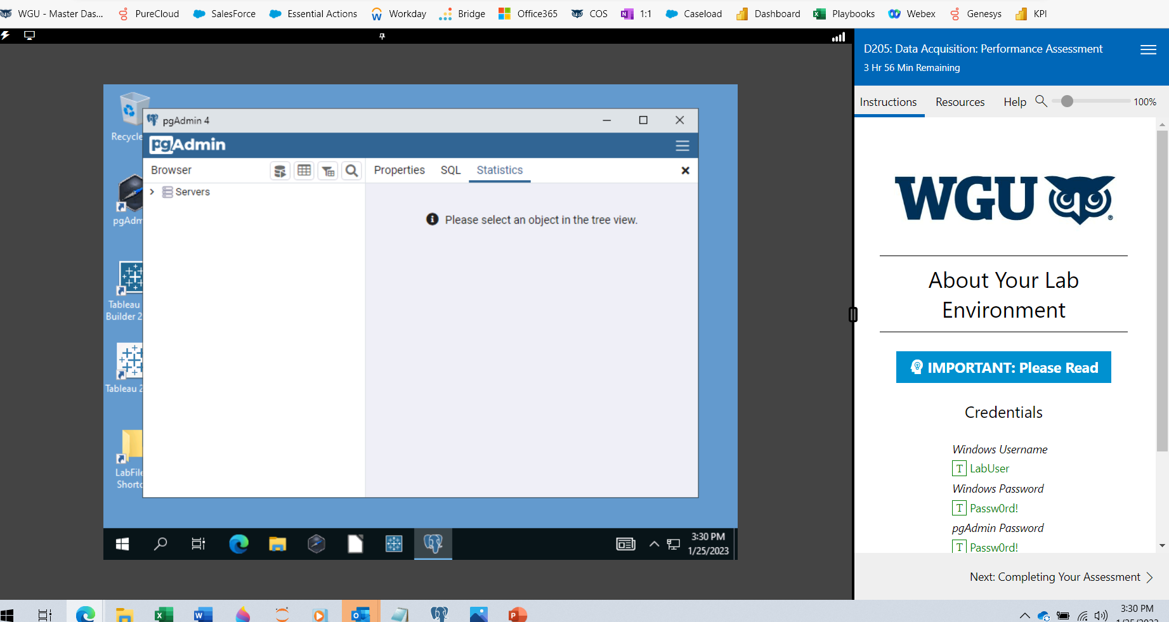
Notes:
At the bottom of the rubric page is Labs on Demand

Slide 11
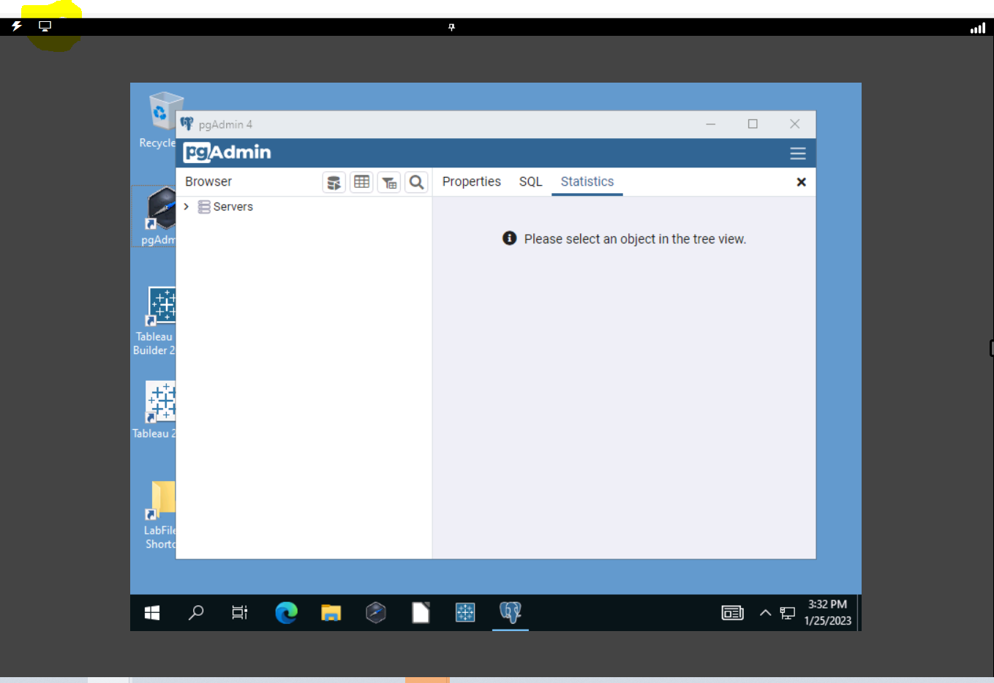
Notes:
At the bottom of the rubric page is Labs on Demand

Slide 12
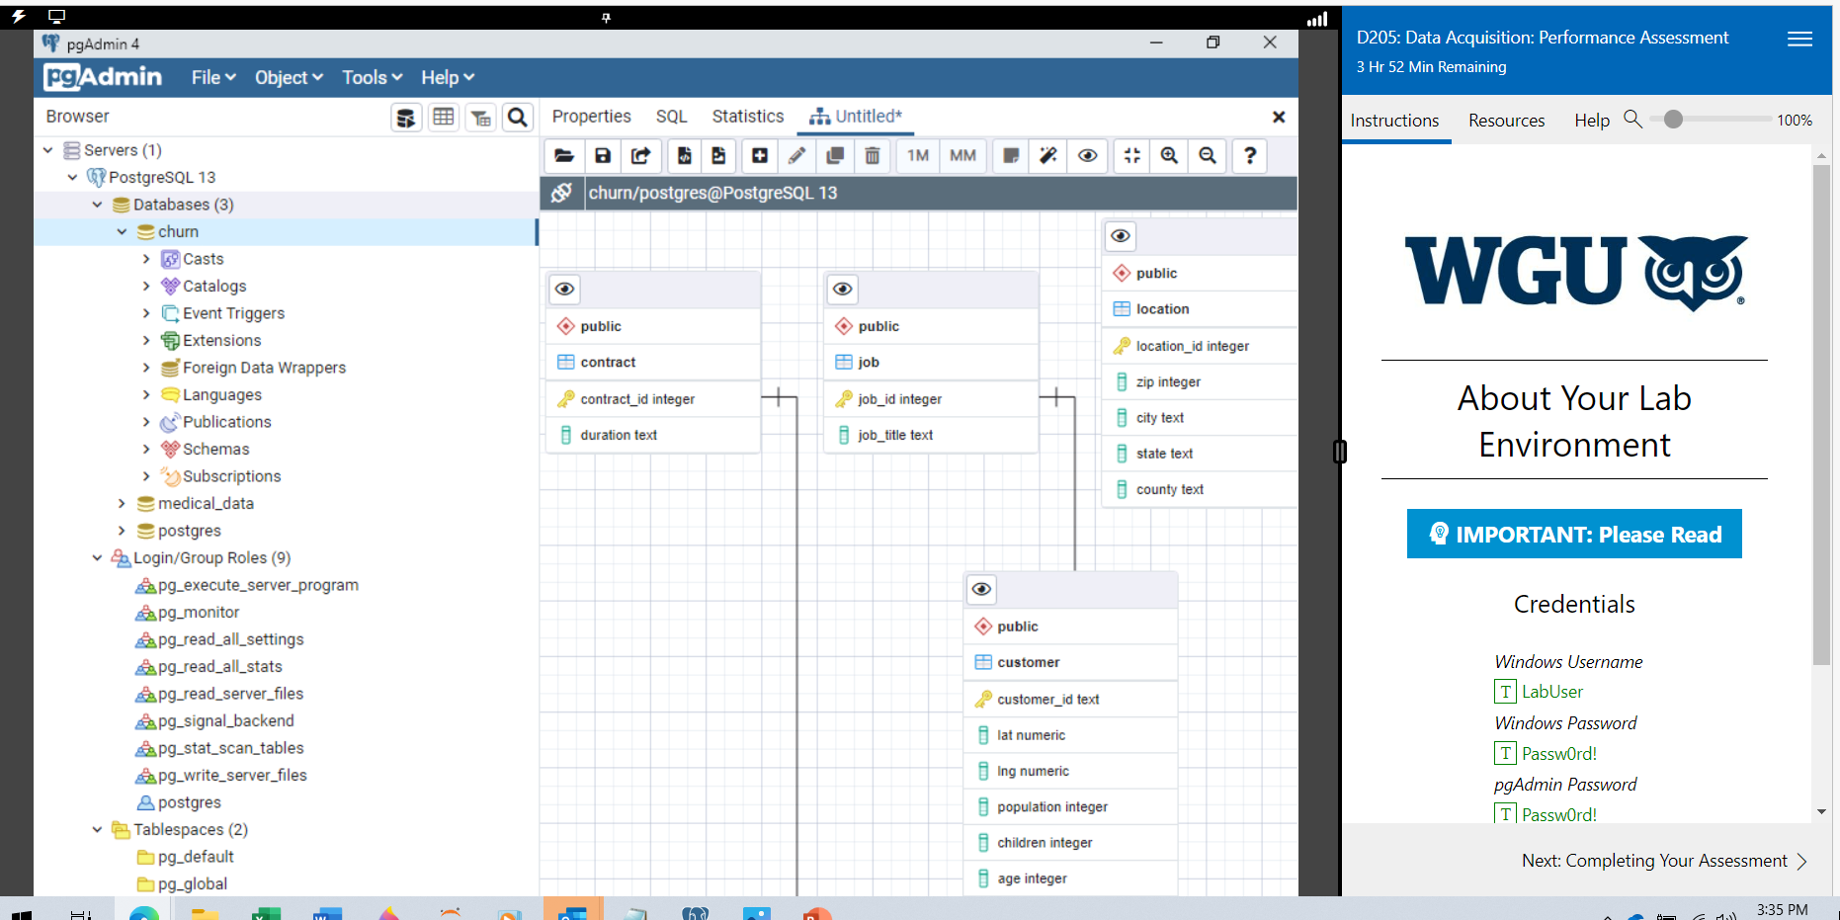
Notes:
At the bottom of the rubric page is Labs on Demand

Slide 13
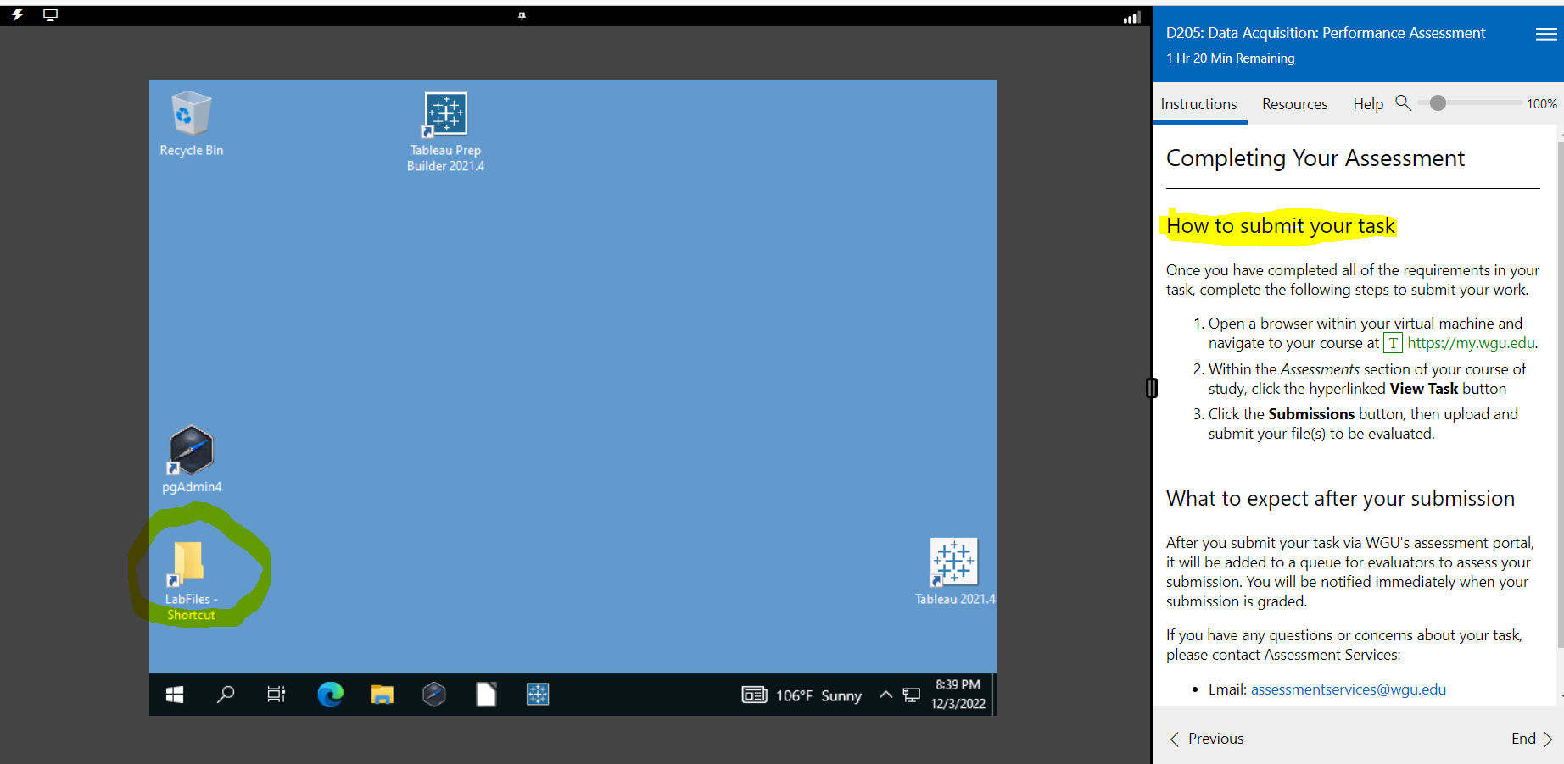
On the left Bringing PgAdmin back to life and Saving your session
On the right side, click the three parallel bars to save your session.’
Bringing PgAdmin back to life and Saving your session.
Notes:
This is the Labs on Demand landing page. It is a Virtual Machine, hosting Postgres. Upper left: bring PgAdmin back to life with Lightning bolt or Display. Upper right: Save your session.

Slide 14
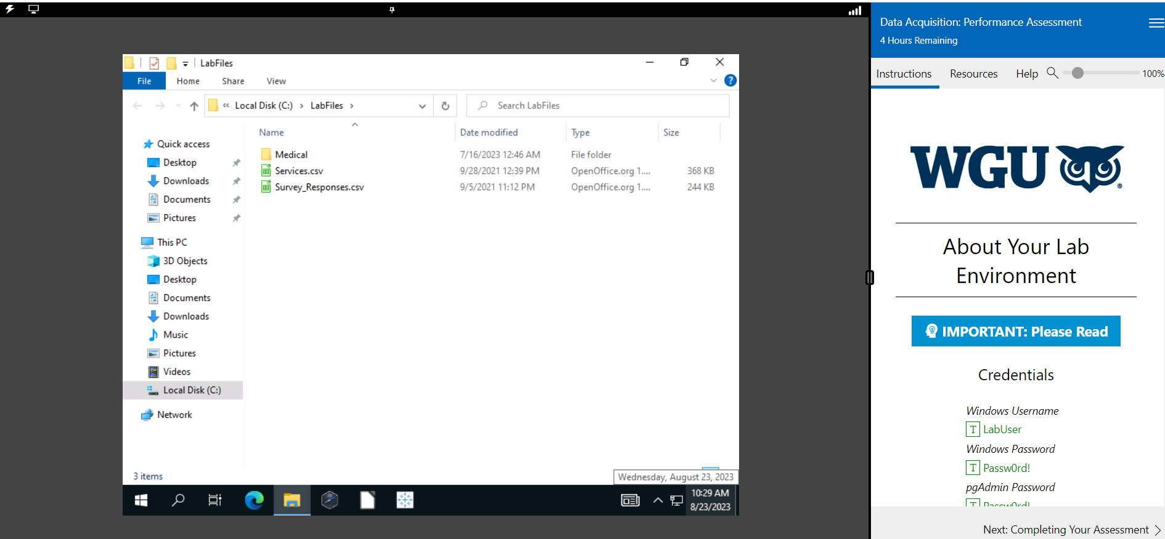
WHERE THE FILES ARE LOCATEDOn the right side, click the three parallel bars to save your session.’
Bringing PgAdmin back to life and Saving your session.
Notes:
This is the Labs on Demand landing page. It is a Virtual Machine, hosting Postgres. Upper left: bring PgAdmin back to life with Lightning bolt or Display. Upper right: Save your session.

Slide 15
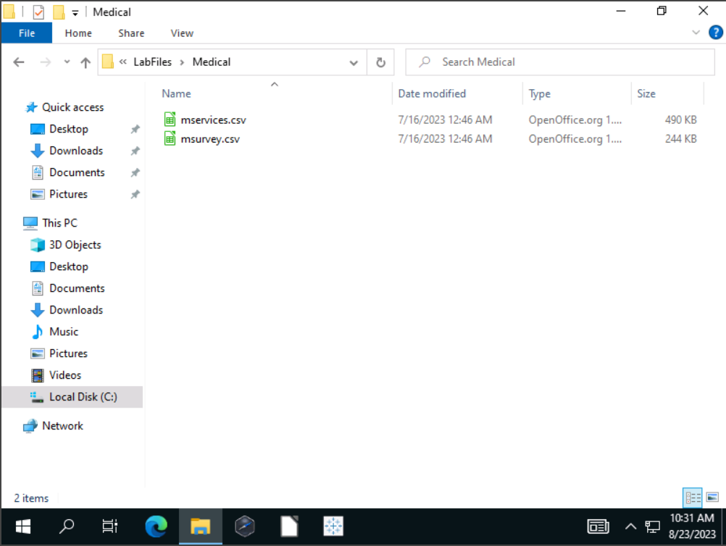
Bringing PgAdmin back to life and Saving your session.
Notes:
This is the Labs on Demand landing page. It is a Virtual Machine, hosting Postgres. Upper left: bring PgAdmin back to life with Lightning bolt or Display. Upper right: Save your session.

Slide 16
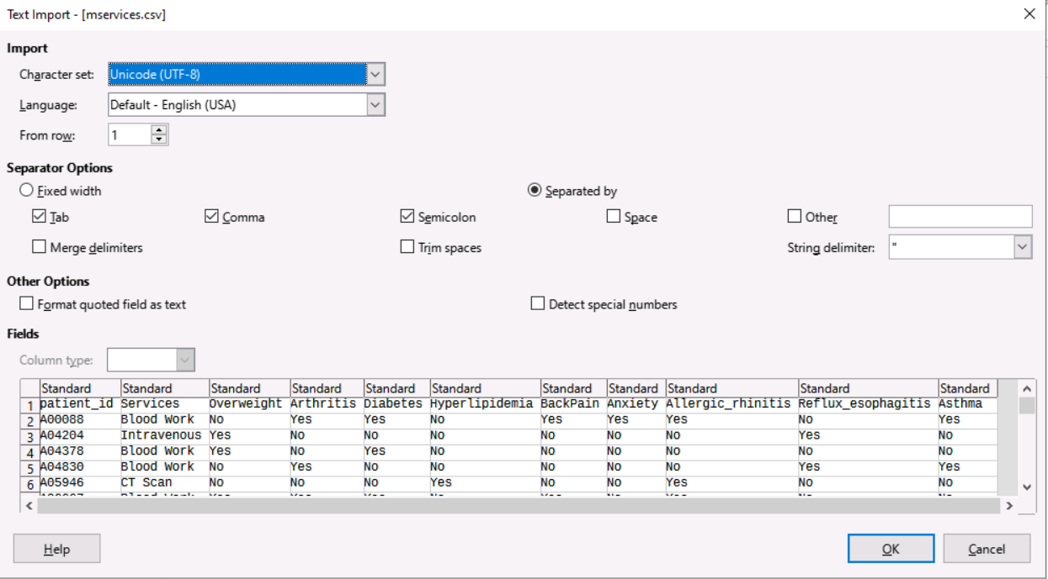
Bringing PgAdmin back to life and Saving your session.
Notes:
This is the Labs on Demand landing page. It is a Virtual Machine, hosting Postgres. Upper left: bring PgAdmin back to life with Lightning bolt or Display. Upper right: Save your session.

Slide 17
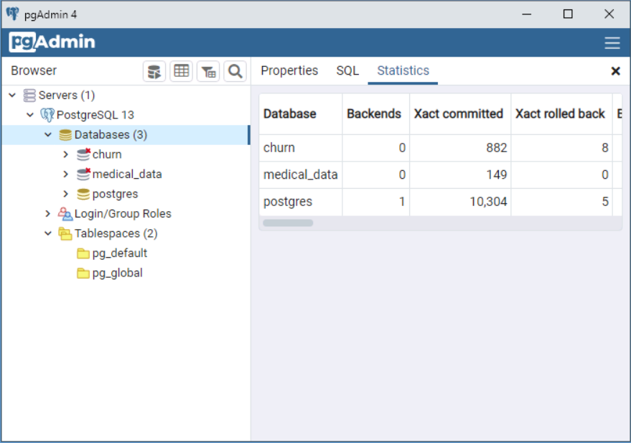
Bringing PgAdmin back to life and Saving your session.
Notes:
This is the Labs on Demand landing page. It is a Virtual Machine, hosting Postgres. Upper left: bring PgAdmin back to life with Lightning bolt or Display. Upper right: Save your session.

Slide 18
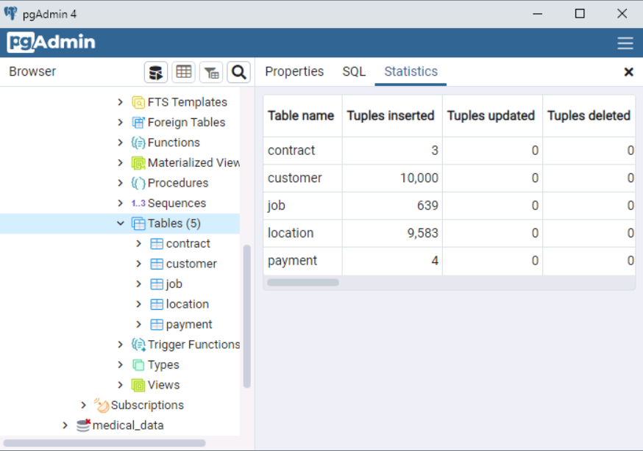
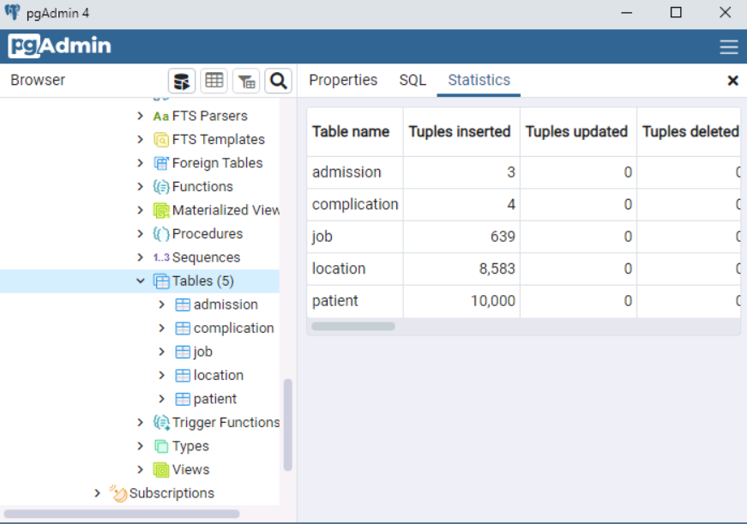
CHURN TABLES MEDICAL TABLES
Bringing PgAdmin back to life and Saving your session.
Notes:
Side-by-side comparison of the two databases: Churn and Medical_data. Each has five tables.

Slide 19

D205 TIPS, TRICKS, TRAPS!
PERFORMANCE ASSESSMENT REPORT
TIP: WRITE A PROFESSIONAL, GRADUATE-LEVEL PAPER. PROVIDE A COVER PAGE, A FULL PARAGRAPH FOR EACH ITEM. BE EXPRESSIVE, EXPLAIN HOW AND WHY, PROVIDE SCREEN SHOTS, SQL CODE WITH YOUR PARAGRAPHS.
TIP: IF YOU ARE UNSURE ABOUT YOUR WRITING OR KNOW THAT YOU NEED HELP, MAKE AN APPOINTMENT WITH THE WGU WRITING CENTER. THE PROS THERE CAN HELP YOU IMPROVE.
TRAP! HEADS UP! DON’T FORGET TO PROOFREAD YOUR WORK. DON’T EXPECT THE EVALUATOR TO DO IT FOR YOU.
TRICK! SPELL-CHECK AND GRAMMAR-CHECK YOUR DOCUMENT. USE GRAMMARLY WHICH HAS A FREE EDITION TO HELP YOU.
TRAP! DO NOT OVERTHINK THIS ASSIGNMENT. DON’T GET DOWN IN THE WEEDS. YOU ONLY NEED ONE RESEARCH QUESTION. KEEP IT SIMPLE!
Notes:
Before we start discussing JOINs be aware of the following TIPs, TRICKs, and TRAPs.

Slide 20

D205 TIPS, TRICKS, TRAPS!
PERFORMANCE ASSESSMENT REPORT
TIP: WRITE A PROFESSIONAL, GRADUATE-LEVEL PAPER. PROVIDE A COVER PAGE, A FULL PARAGRAPH FOR EACH ITEM. BE EXPRESSIVE, EXPLAIN HOW AND WHY, PROVIDE SCREEN SHOTS, SQL CODE WITH YOUR PARAGRAPHS.
TIP: IF YOU ARE UNSURE ABOUT YOUR WRITING OR KNOW THAT YOU NEED HELP, MAKE AN APPOINTMENT WITH THE WGU WRITING CENTER. THE PROS THERE CAN HELP YOU IMPROVE.
TRAP! HEADS UP! DON’T FORGET TO PROOFREAD YOUR WORK. DON’T EXPECT THE EVALUATOR TO DO IT FOR YOU.
TRICK! SPELL-CHECK AND GRAMMAR-CHECK YOUR DOCUMENT. USE GRAMMARLY WHICH HAS A FREE EDITION TO HELP YOU.
TRAP! DO NOT OVERTHINK THIS ASSIGNMENT. DON’T GET DOWN IN THE WEEDS. YOU ONLY NEED ONE RESEARCH QUESTION. KEEP IT SIMPLE!
Notes:
Before we start discussing JOINs be aware of the following TIPs, TRICKs, and TRAPs.

Slide 21

D205 TIPS, TRICKS, TRAPS!
PERFORMANCE ASSESSMENT REPORT
TIP: FOR THIS PA YOU WILL CREATE A SIXTH TABLE BASED ON EITHER THE SERVICES OR THE SURVEY_RESPONSES FILES. THEN YOU WILL LOAD THE TABLE FROM THE FILE. YOU WILL HAVE 10,000 ROWS IN YOUR NEW TABLE.
TIP: THE CUSTOMER TABLE HAS 10,000 ROWS AS DO THE EXTERNAL FILES. CONSIDER THIS RELATIONSHIP.
TRAP! DON’T FORGET TO CREATE YOUR PRIMARY KEY AND SHOW THE RELATIONSHIP BETWEEN YOUR NEW TABLE AND CUSTOMER.
TRICK! REMEMBER TO CREATE YOUR ERD AFTER YOU CREATE YOUR NEW TABLE SO THAT IT SHOWS UP IN THE SCHEMATIC.
TRAP! DO NOT OVERLOOK WHAT FOREIGN KEYS ARE FOR AND HOW THEY ENFORCE REFERENTIAL INTEGRITY.
Notes:
Before we start discussing JOINs be aware of the following TIPs, TRICKs, and TRAPs.

Slide 22
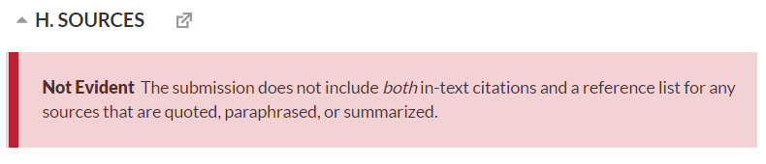
DON’T LET THIS HAPPEN TO YOU!
Write Professionally. Spell-check, grammar-check. Proofread your work.
Example of an Intext citation:
It is important to have a sufficient number of rows to build a properly fitted Linear Regression Model (Austin & Steyerberg, 2015).
The Matching Reference:
Austin, P., & ; Steyerberg, E. (2015, January 22). The number of subjects per variable required in linear regression analyses. Retrieved October 13, 2020, from https://www.sciencedirect.com/science/article/pii/S0895435615000141
Notes:
Use at least two intext citations and include web sources that you find on the internet.

Slide 23
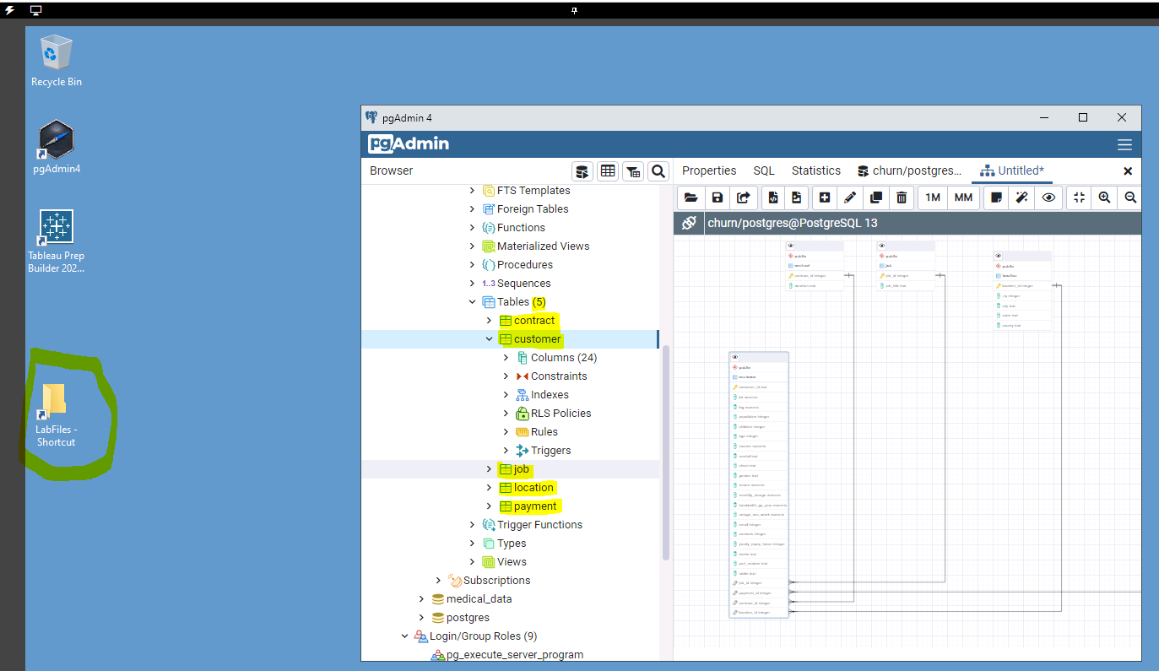
Notes:
Double-click the pgAdmin4 black cube brings up the databases and their tables. Just use the browser, expand down to the tables.

Slide 24
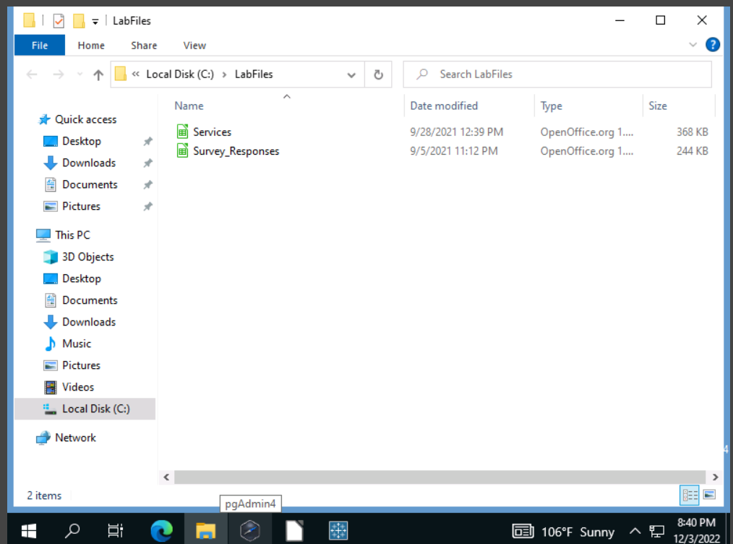
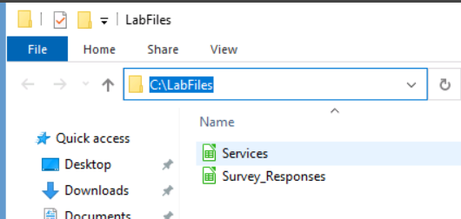
On the lefDOUBLE-CLICK ON THE LabFiles Folder to see the two datafiles.
On the right side, click the three parallel bars to save your session.’
Bringing PgAdmin back to life and Saving your session.
Notes:
This is the Labs on Demand landing page. It is a Virtual Machine, hosting Postgres. Upper left: bring PgAdmin back to life with Lightning bolt or Display. Upper right: Save your session.

Slide 25

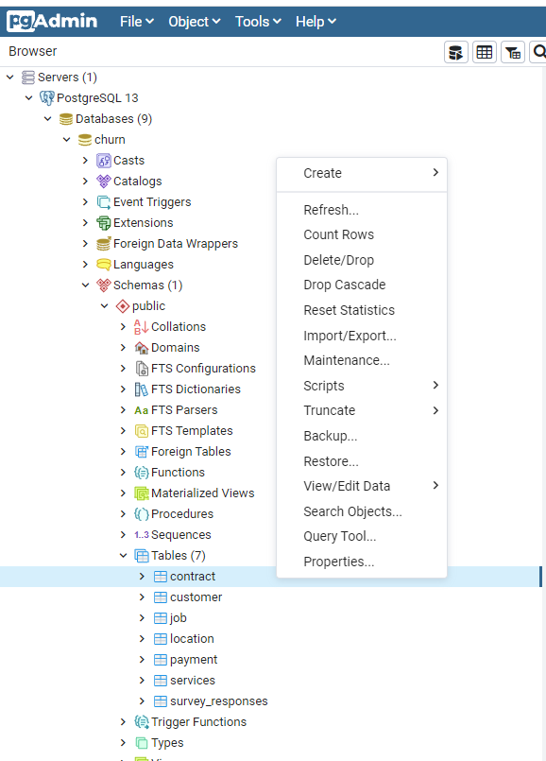
YouTube video on how to use PgAdmin:
https://www.youtube.com/watch?v=Dd2ej-QKrWY
Notes:
This is the table menu. Just right-click on a table to see it.

Slide 26
Services.csv file
Customer_id | InternetService | Phone | Multiple | OnlineSecurity | OnlineBackup | DeviceProtection | TechSupport
A00088 | Fiber Optic | Yes | Yes | Yes | No | No | No
A04204 | DSL | Yes | Yes | Yes | Yes | Yes | Yes
A04378 | None | Yes | Yes | No | No | No | Yes
A04830 | DSL | Yes | Yes | Yes | No | Yes | No
A05946 | Fiber Optic | No | No | No | No | No | No
A06667 | DSL | Yes | Yes | No | Yes | Yes | Yes
A08755 | Fiber Optic | Yes | No | No | Yes | Yes | Yes
A100934 | DSL | Yes | No | Yes | No | No | No
A103291 | DSL | No | Yes | No | No | No | Yes
A105398 | DSL | Yes | No | Yes | No | Yes | Yes
A106835 | Fiber Optic | Yes | Yes | No | No | Yes | No
A118391 | DSL | Yes | No | No | No | No | No
A121664 | Fiber Optic | Yes | Yes | Yes | No | No | Yes
A124923 | None | Yes | No | No | Yes | No | Yes
Notes:
This is what the services.csv file looks like. Eight columns, all varchar. Remember to create your table with lowercase table name and lowercase column names.

Slide 27
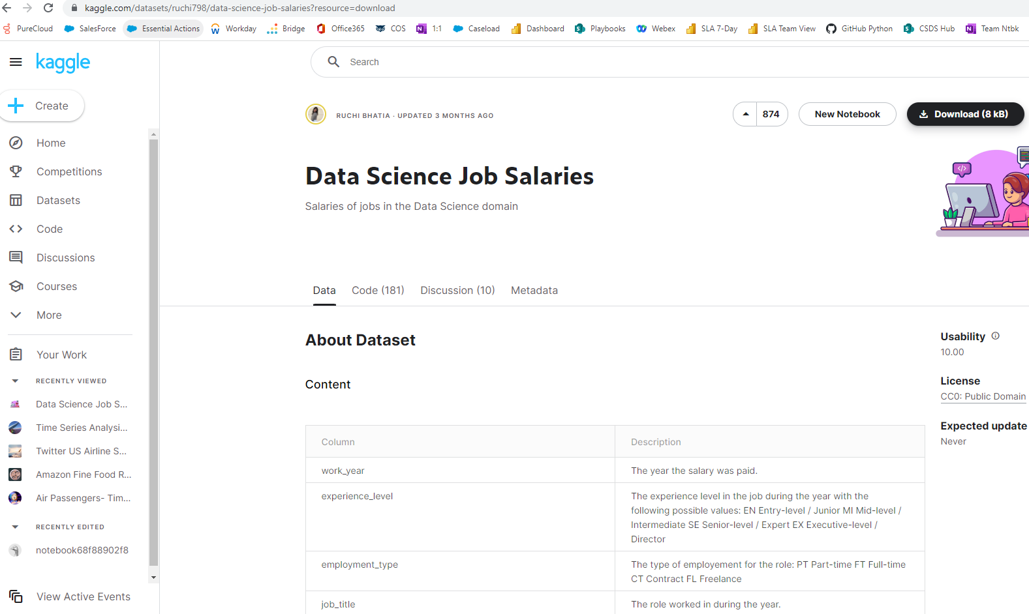
Services.csv file
Notes:
Here is a Kaggle dataset that you can download and load into your Postgres database as a table.

Slide 28
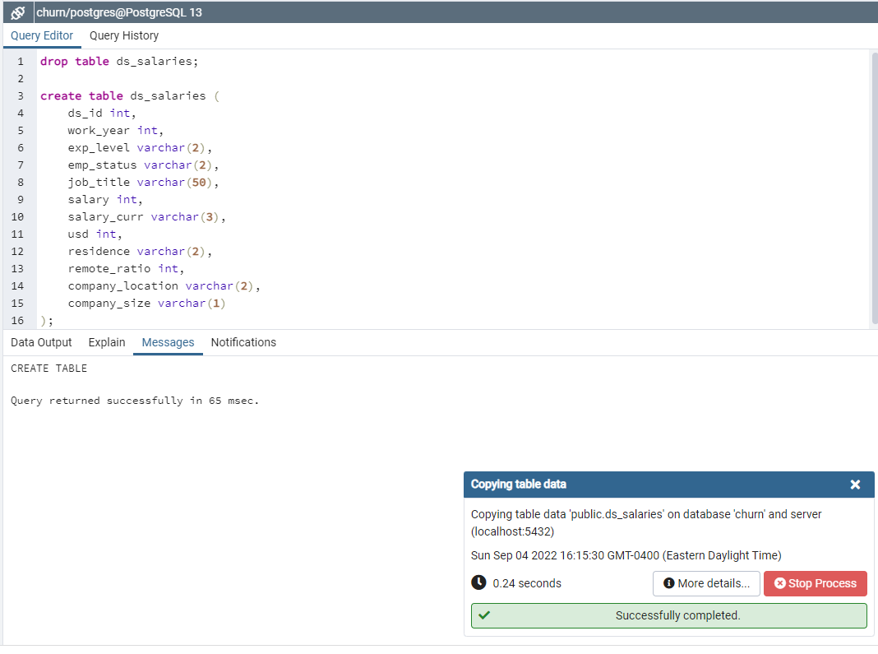
Services.csv file
Z982061,None,Yes,Yes,Yes,Yes,No,No,
Z984566,None,Yes,No,Yes,No,Yes,Yes,
Z985297,Fiber Optic,Yes,Yes,Yes,No,No,Yes,
Z987566,Fiber Optic,Yes,No,No,No,Yes,No,
Z988959,DSL,Yes,Yes,No,Yes,Yes,Yes,
Z990229,DSL,Yes,Yes,Yes,No,Yes,Yes,
Z991519,DSL,Yes,No,No,Yes,No,No,
Z993409,None,Yes,Yes,Yes,Yes,Yes,Yes,
Z99425,DSL,Yes,Yes,No,No,No,Yes,
Z994762,Fiber Optic,Yes,Yes,No,Yes,Yes,No,
Z995043,DSL,Yes,Yes,No,Yes,No,No,
Z99512,DSL,Yes,Yes,No,No,No,Yes,
Z996577,Fiber Optic,Yes,Yes,Yes,No,No,Yes,
Z999359,DSL,Yes,No,No,No,Yes,Yes,
Notes:
First, create the table, then you can import the data.

Slide 29
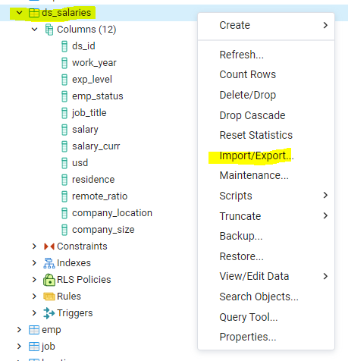
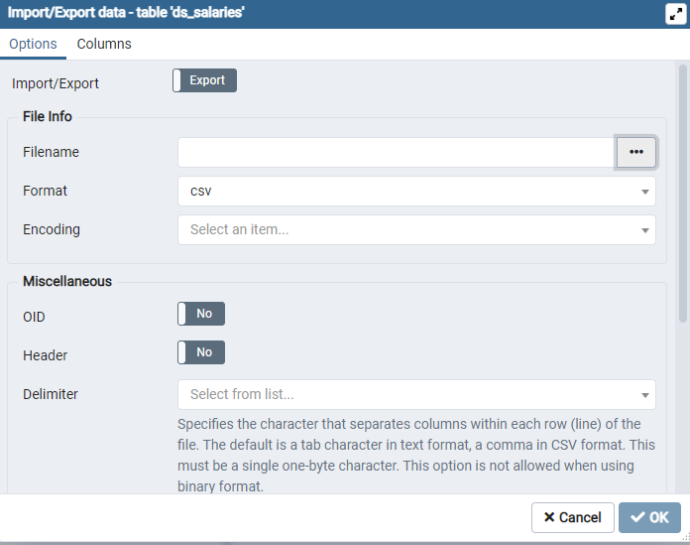
Notes:
In order to import, right-click on the table you are importing.

Slide 30
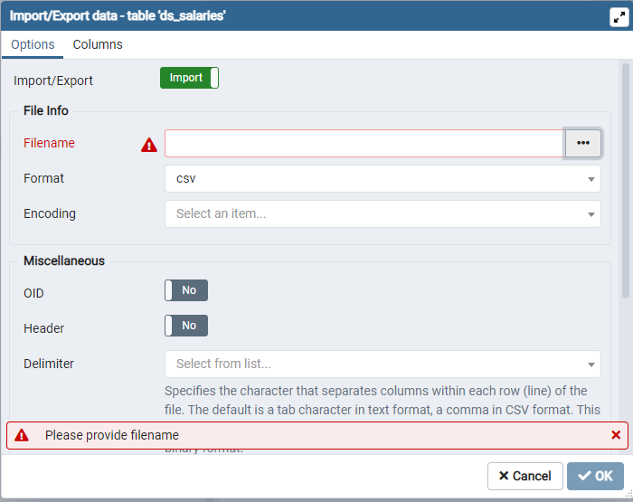
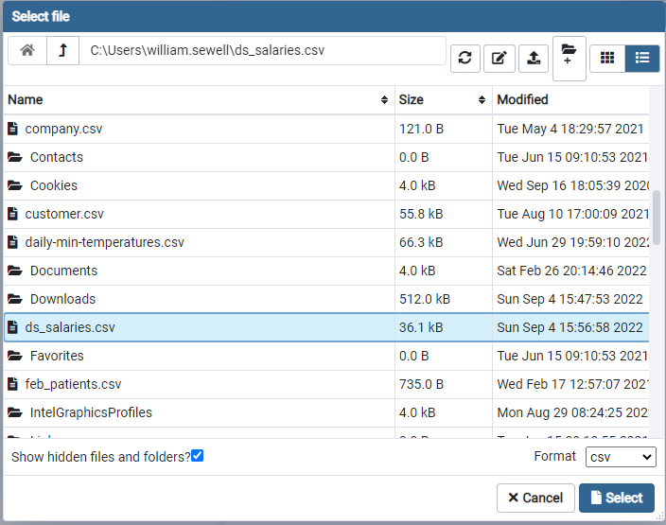
Notes:
Follow the prompts in the Import dialog box.

Slide 31
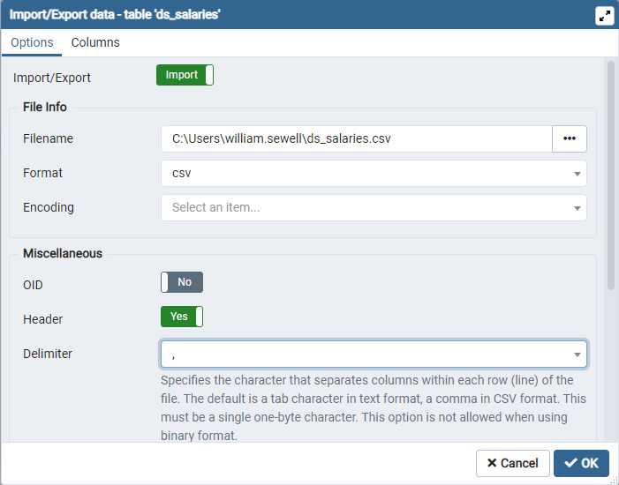
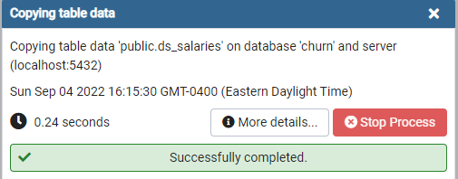
Notes:
Once completed, like above, click OK.

Slide 32
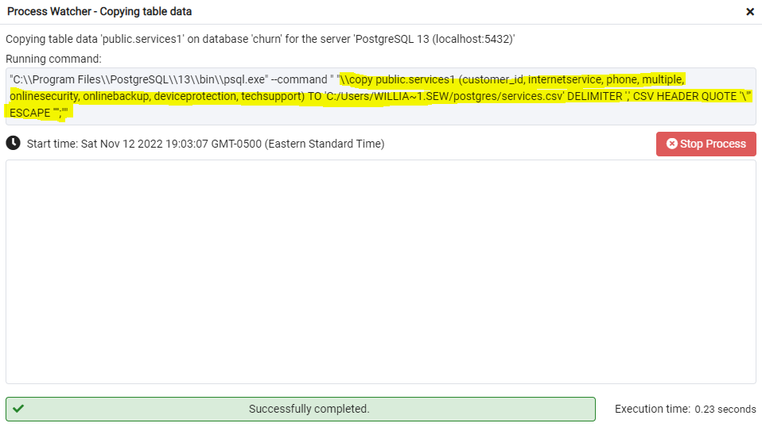
MORE DETAILS
Notes:
Once completed, like above, click OK.

Slide 33
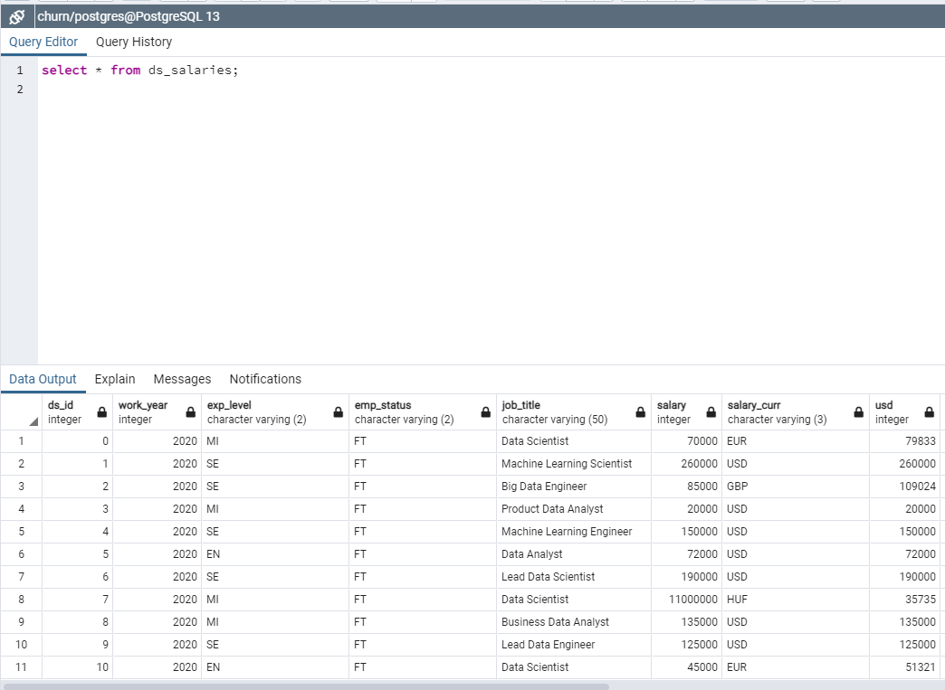
Notes:
Check to see if the data is there.

Slide 34
Perform the following tasks to combine an existing data set with some external data:
A. Summarize a research question that can be answered using both the original database and the add-on CSV data. The question should require data from both these data sources.
1. Identify which data from the original data set and the add-on CSV file are needed to answer the research question.
B. Create a logical data model for the add-on CSV file by evaluating the data contained in the file and emphasizing the relational constraints.
1. Write SQL code that creates a table that accommodates the extension of the logical data model to a physical data model by specifying the field types and relevant keys.
2. Write SQL code that loads the data from the add-on CSV file into the table created in part B1.
C. Write SQL statement(s) for a query or queries that inform the research question summarized in part A.
Provide a CSV file or files that capture the results from the query or queries.
D. Determine how often the add-on file should be acquired and refreshed in the database for the data to remain relevant to the business and the research question.
Create an SQL script that performs the process of loading the add-on data.
Write a SQL statement: copy tablename from ‘c:\path\filename.csv’ delimiter ‘,’ csv header;
https://www.postgresqltutorial.com/import-csv-file-into-posgresql-table/
Perform the following tasks to combine an existing data set with some external data:
A. Summarize a research question that can be answered using both the original database and the add-on CSV data. The question should require data from both these data sources.
1. Identify which data from the original data set and the add-on CSV file are needed to answer the research question.
B. Create a logical data model for the add-on CSV file by evaluating the data contained in the file and emphasizing the relational constraints.
1. Write SQL code that creates a table that accommodates the extension of the logical data model to a physical data model by specifying the field types and relevant keys.
2. Write SQL code that loads the data from the add-on CSV file into the table created in part B1.
C. Write SQL statement(s) for a query or queries that inform the research question summarized in part A.
Provide a CSV file or files that capture the results from the query or queries.
D. Determine how often the add-on file should be acquired and refreshed in the database for the data to remain relevant to the business and the research question.
Create an SQL script that performs the process of loading the add-on data.
Write a SQL statement: copy tablename from ‘c:\path\filename.csv’ delimiter ‘,’ csv header;
https://www.postgresqltutorial.com/import-csv-file-into-posgresql-table/
Notes:
This is the rubric. Only five items, with B2 and E being the same.

Slide 35
F. Provide a Panopto video recording that includes a demonstration of the functionality of the code used for the analysis and a summary of the programming environment.
Note: For instructions on how to access and use Panopto, use the "Panopto How-To Videos" web link provided below. To access Panopto's website, navigate to the web link titled "Panopto Access" and then choose to log in using the “WGU” option. If prompted, log in using your WGU student portal credentials, and then it will forward you to Panopto’s website.
To submit your recording, upload it to the Panopto drop box titled “XXXX.” Once the recording has been uploaded and processed in Panopto's system, retrieve the URL of the recording from Panopto and copy and paste it into the Links option. Upload the remaining task requirements using the Attachments option.
G. Record the web sources used to acquire data or segments of third-party code to support the application. Be sure the web sources are reliable.
H. Acknowledge sources, using in-text citations and references, for content that is quoted, paraphrased, or summarized.
I. Demonstrate professional communication in the content and presentation of your submission.
Panopto Access
Notes:
The remainder of the rubric.

Slide 36
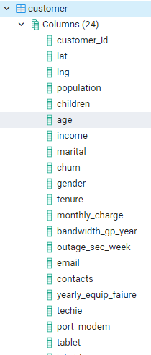
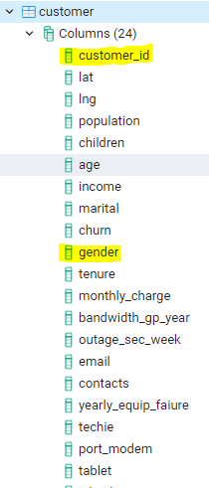
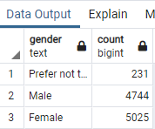
select customer_id, count(*) from services group by customer_id order by 2 desc;
select tenure from customer order by tenure desc;
select gender, count(*) from customer group by gender;
Notes:
Some queries to try.

Slide 37
Links to the Churn Tables:
Contract
customer
job
location
payment
services
survey_responses
Links to the Medical Tables:
admission
complication
job
location
patient
servicesaddon
survey_responses_addon
Ancillary Files:
Take 5 Loading Tables
Moving FilesTo_From_VM
Take Five Loading Tables Video
Notes:
Here are links to the data as well as how to import and to transfer files to and from the Labs on Demand and your PC.

Slide 38
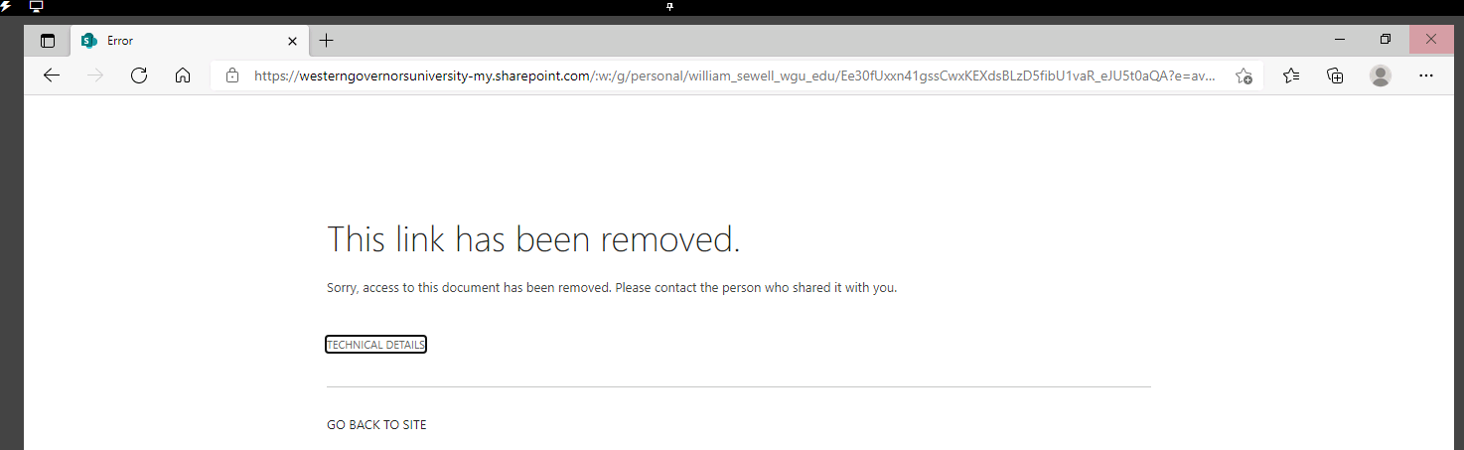
MOVING FILES TO AND FROM THE LABS ON DEMAND DESKTOP
There are two ways to upload or download files to and from the VM (Labs on Demand).
First method
Step 1. Email files to yourself using a Yahoo or Gmail email account.
Step 2 Log on to the virtual desktop.
Step 3. Open a browser on the virtual desktop.
Step 4. Connect to your Yahoo or Gmail account.
Step 5. Open your email and access your files, save to the desktop.
Second Method:
Step 1. Open a browser.
Step 2. Type in a shared document link. (You can create this link as a Microsoft OneDrive link by clicking on the file and sharing it).
Step 3. You will see the following screen.
Notes:
Here are links to the data as well as how to import and to transfer files to and from the Labs on Demand and your PC.

Slide 39
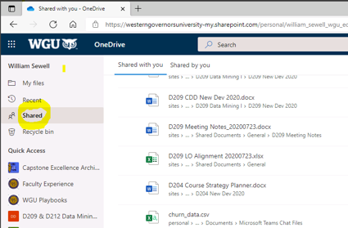
So, the trick is when the error page appears like above, just click the small link "Go back to site".
Then, it will prompt you to login with your WGU credentials. Next, select Shared files
(like the screenshot below) and navigate to the file you want to upload to the VM.
Notes:
Here are links to the data as well as how to import and to transfer files to and from the Labs on Demand and your PC.

Slide 40
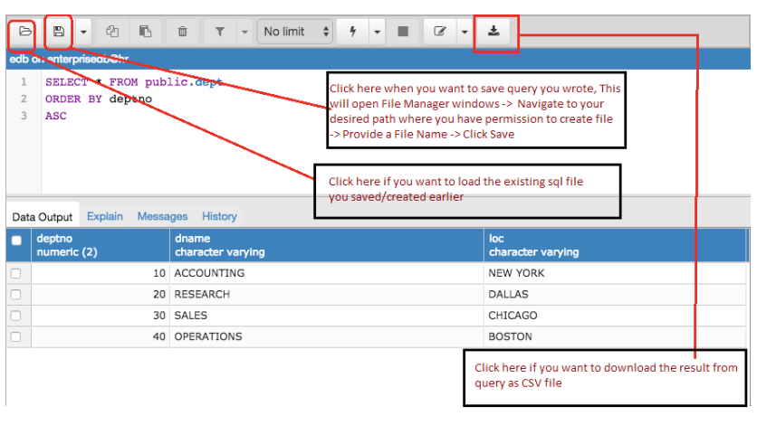
Notes:
Saving your results

Slide 41
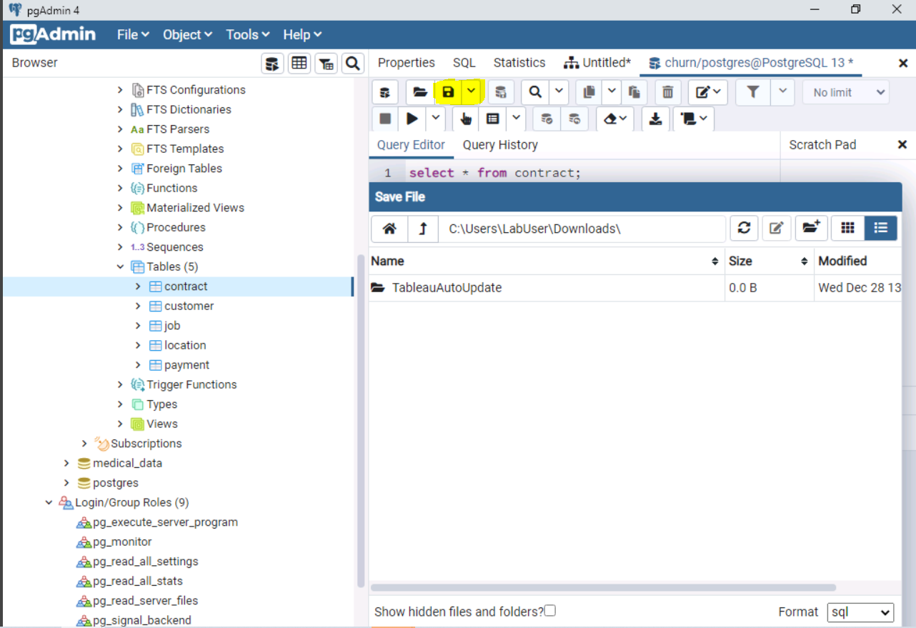
Click the disk icon
To save your query to a SQL file.
Notes:
How to save your query.

Slide 42
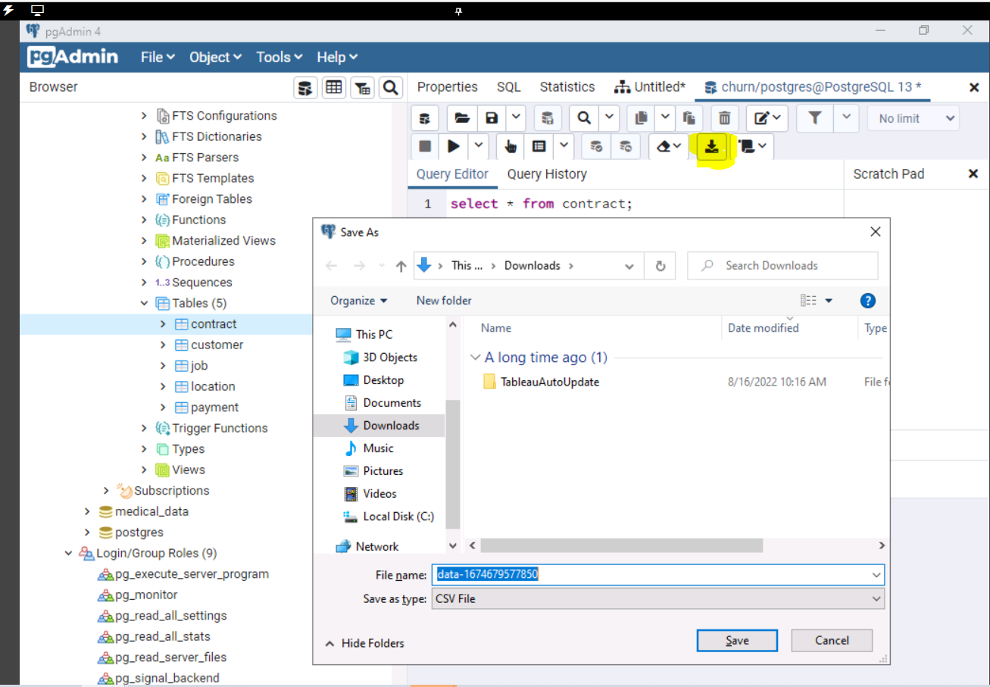
Click the download icon
To save your result set to a CSV file.
Notes:
How to save your results set.

Slide 43
SEVEN TYPES OF JOINs:
Join the tables with an INNER JOIN.
Join the tables with a LEFT JOIN.
Join the tables with a RIGHT JOIN.
Join the tables with a FULL JOIN.
Join the tables with a NATURAL JOIN.
Join the tables with a JOIN Using.
7. Join the tables with a CROSS JOIN.
Notes:
This is a simple SQL script that you can use to do simple table JOINs for INNER and OUTER JOINS both left and right JOINs.

Slide 44
COPY THIS DATA (DIY):
Create table emp (empid int, lname varchar(20), deptid int );
Insert into emp values (1, 'Jones', 10);
Insert into emp values(2, 'Riley', 10);
Insert into emp values (3, 'Peters', 20);
Insert into emp values (4, 'Thomas', 20);
Insert into emp values (5, 'Ryan', NULL);
Create table dept (deptid int, deptname varchar(20), location varchar(2));
Insert into dept values (10, 'Sales', 'NE');
Insert into dept values (20, 'Accounting', 'NE');
Insert into dept values (30, 'Marketing','SW');
Notes:
This is a simple SQL script that you can use to do simple table JOINs for INNER and OUTER JOINS both left and right JOINs.

Slide 45
COPY THESE JOINS FOR PRACTICE (DIY):
select * from emp, dept where emp.deptid = dept.deptid; -- INNER JOIN QUERY
select * from emp e, dept d where e.deptid = d.deptid; -- INNER JOIN QUERY WITH ALIAS
select empid, e.deptid, deptname, location from emp e INNER JOIN dept d ON e.deptid = d.deptid;
select * from emp LEFT OUTER JOIN dept ON emp.deptid = dept.deptid;
select * from emp RIGHT OUTER JOIN dept ON emp.deptid = dept.deptid;
select * from emp FULL OUTER JOIN dept ON emp.deptid = dept.deptid;
select * from emp JOIN dept USING (deptid);
select * from emp NATURAL join dept;
select * from emp CROSS JOIN dept;
Notes:
This is a simple SQL script that you can use to do simple table JOINs for INNER and OUTER JOINS both left and right JOINs.

Slide 46
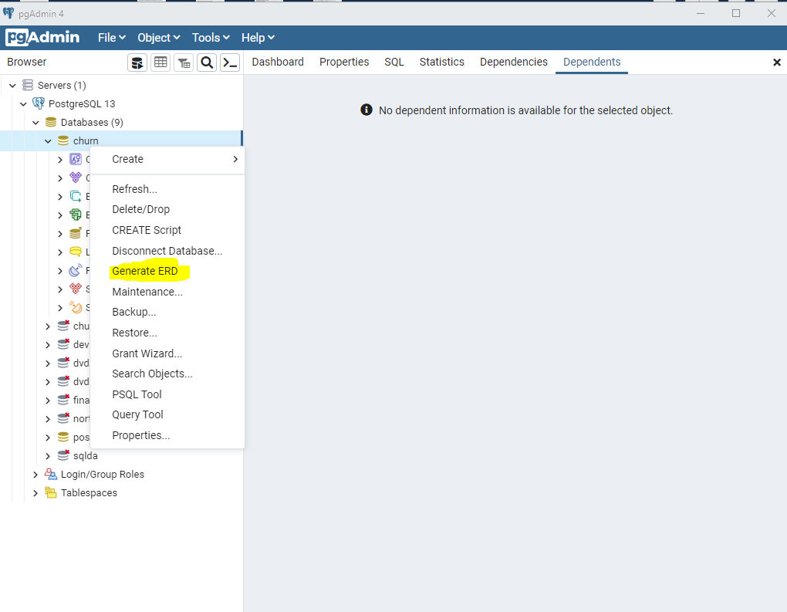
Notes:
How to create an ERD (logical data model).

Slide 47
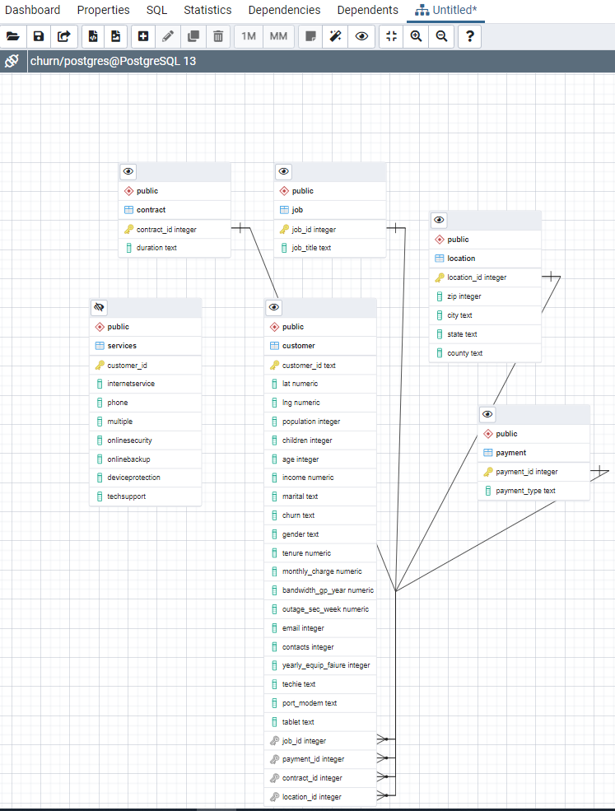
Using the ERD tool in
PgAdmin. See the document
Below for more information.
https://www.pgadmin.org/docs/pgadmin4/development/erd_tool.html
Notes:
PgAdmin does all the work for you.

Slide 48
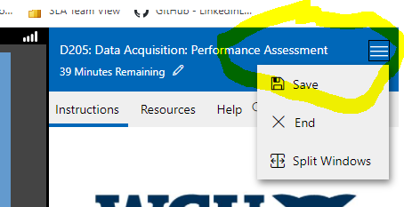
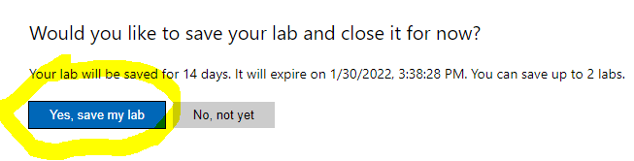
Bringing PgAdmin back to life
On the left side, use the lightning bolt to bring pgAdmin back to live, if it
Ghosts out on you.
On the right side, click the three parallel bars to save your session.’
Notes:
How to clear pgAdmin if it gets stuck. How to save your session and time remaining.

Slide 49
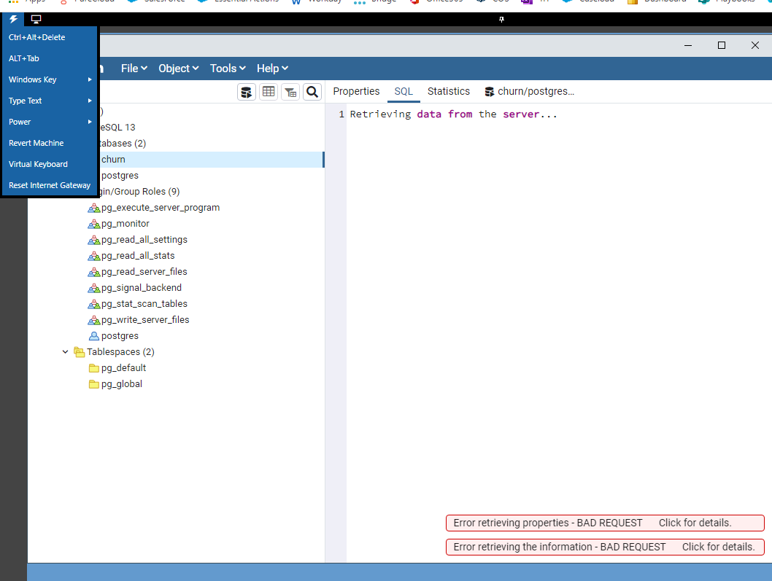
Revive pgAdmin.
If PgAdmin is not cooperating.
After waiting and clicking,
if it does not come up.
Click on the lightning bolt
and choose Revert Machine.
Or you can try the Display
icon and toggle between
full screen and fit window.
Notes:
Clearing pgAdmin so that it responds.

Slide 50
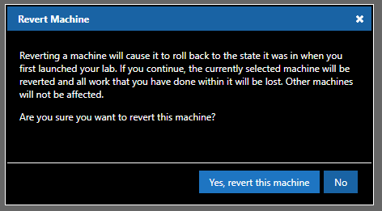
If PgAdmin is not cooperating. After waiting and clicking, if it does not come up.
Notes:
Forcing pgAdmin to respond.

Slide 51
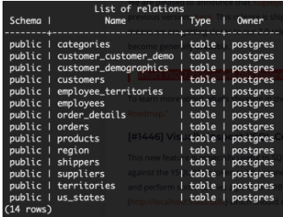
LOGICAL v. PHYSICAL DATABASE
In the logical database we create the Entity (Enterprise) Relationship Model (ERM). An ERM contains the flow of the data, often depicted by a Data Flow Diagram (DFD) and a Process Flow Diagram (PFD). These designs will create a description of the tables (entities), indexes, views, and other needed items like procedures and functions.
Then we create the Entity Relationship Diagram (ERD). This is a schematic that shows the relationship between the entities such as 1:1, 1:M, M:N. ERD tools like DbArtisan, ER Studio, ERWIN, LucidChart.com and Rational Rose can be used not only to create the ERD but also the physical database.
The physical database contains the structures or containers such as tables, tablespaces, indexes, procedures, functions, views, triggers, Materialized Views and so on.
Physical Implementation of the Northwind Database
DVD Rental: https://www.postgresqltutorial.com/postgresql-getting-started/postgresql-sample-database/
Notes:
More on ERD tools.

Slide 52
TESTIMONIALS
“ Thank you so much for the detailed tips in Webinar and the wonderful notes.” AC .
“ really helped me to understand the concepts and pass the exam on the first attempt!” Sharon B.
“I can’t believe how the webinars really helped me understand databases!” Mark F.
“Everybody should study these webinars. They are exactly what you need to learn.” John C.
“I was lost. I could not understand what they wanted. Attended your Webinar and I passed!” Riva K.
“The course material did not match the PA. Once I saw Dr. Sewell’s videos then I got it!” Shirley B.
“I love the presentations and learned more than from the book! Thanks, Dr. Sewell!” Max S.
“Your live presentations were instrumental to my passing this course.” Bryan F.
“I really didn’t know where to start. Your live webinars and videos are the best!” Ravi G.

Slide 53


Dr. William Sewell
Course Instructor
College of Information Technology
Western Governors University
877-435-7948 ext 5377 or (385) 428-5377
Text me at: 954-802-2225
4001 South 700 East, Suite 700
Salt Lake City, UT 84107
william.sewell@wgu.edu
Appointments
Don’t forget I am only a phone call, away!
Notes:
No matter how far away.

Slide 54
SQL Sunday
D205 SQL for Data Analytics
Postgres database
Notes:
D205 SQL Sunday.

